Slide 1
NYS AHPERD CONFERENCE November 8, 2007
AFFECTING CHANGE IN YOUR PHYSICAL EDUCATION PROGRAM

Slide 2
Why teams Fail
Goal is unclear.
Meeting dominated by individuals.
Fear of ridicule by team members.
Competition within the team.
Put downs and attack responses.
Sub-groups formed creating allies and adversaries.
Diversionary Tactics to gain power within the group.
Previous failure which prevents acceptance of new ideas.

Slide 3
#1 Ingredient: Establish Trust
Organizational trust begins with individual trust.
Being 100% honest.
Support and help others.
Respectful of others.
Encourage others to express disagreement.
Communicate accurate information.
Maintaining self control.
Sharing information in an open and friendly way.
Cooperate with others.
Ask questions/listen to responses.

Slide 4
Getting On The Same Page!
Consensus building
Develop a “give and take” philosophy.
Create a mission statement for physical education using consensus.
A mission statement binds people together in a common purpose and gives teachers an opportunity to declare what they think.

Slide 5
Mission Statement
Conveys what a group believes to be significant.
It is a tool that guides and analyzes actions taken by the group.
It is a reminder to do the right thing.
Commits all to support the statement.
It should be explicit, clearly defined, and specific.

Slide 6
Guidelines
Vision
Common language
Sense of purpose
Meaningful
Clear and concise
Action

Slide 7
Schenectady City School District
The mission of the Schenectady City School District Physical Education Program is to empower each student with the skills and knowledge necessary to be a physically active person who will:
Demonstrate an understanding of the concepts for being fit and healthy.
Demonstrate sportsmanship and positive social behaviors.
Live a healthy lifestyle, and
Safely participate in a variety of sports and activities throughout one’s life.

Slide 8
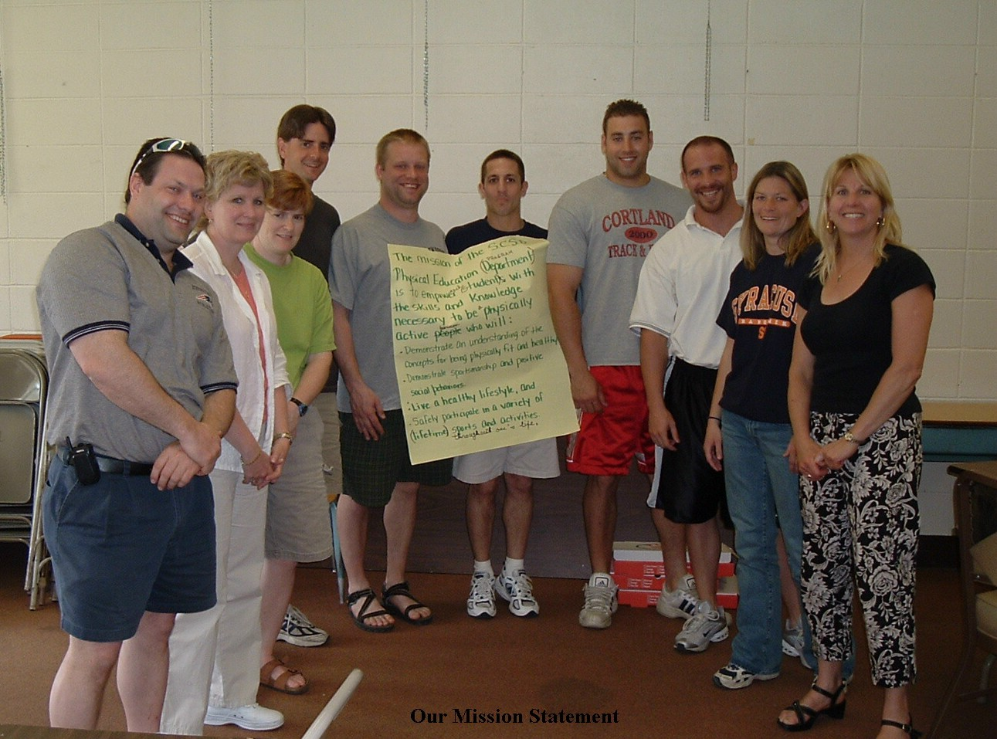
A Mission Statement
defines what a person will know and be able to demonstrate by the time they reach commencement level.

Slide 9
What we need to keep in mind is…
SED and the Board of Regents have approved the NYS Learning Standards.
School districts have the responsibility to ensure students achieve the learning standards.
School districts have the responsibility to provide evidence that students have achieved the standards by the time they graduate.
Assessing students is the only credible method school districts and teachers have to provide the evidence.
Notes:
READ THE SLIDE
It is mandated that schools teach to the learning standards and provide evidence that students have achieve the learning standards by the commencement level.
Up until this point we have never had assessments endorsed by SED. Those schools administering assessments developed their own which vary greatly from school to school. Some assessments may be easy; even too easy, other schools may be administering assessments that are extremely difficult.
We now have assessments that every school can use knowing they are state endorsed and provide reasonable expectations for students at the commencement level.

Slide 10
Implementing Assessments
Assessments are tools that can be used to determine what students know and what they need to know.
Assessments will validate what students have learned.
Assessments can be used to provide evidence that students have attained the learning standards.

Slide 11
Assessments can have…..
An impact on curriculum
An impact on instruction
An effect on student accountability and grading
An effect on program accountability and reporting
A profound impact on learning
Notes:
READ THE SLIDE

Slide 12
Examples of fourth Grade Benchmark Assessments
Begins to demonstrate increasing competence in more advanced and specialized skills (e.g. throwing and catching a ball).
recognizes similarities and differences between movement skills
Gains better understanding of offensive and defensive strategies.
recognizes physical activity as a positive opportunity for social and group interaction
Utilizes time effectively to complete assigned tasks

Slide 13
Assessments Drive Curriculum
Assessments will drive the curriculum which in turn impacts instruction.
It is important for teachers to utilize formative and summative assessments.

Slide 14
Using Standards and Assessment in your Program: How To Begin
The entire physical education department should be on the same page.
Compare your program with State standards & assessments
Decide on a mission statement
Develop a sequential curriculum that addresses bench mark assessments and ensures students achieve the NYS Learning Standards.
Physical education requirements and expectations should be consistent from teacher to teacher, and explained to students.
Establish standardized bench mark assessments for specific grade levels: (2,5,8, and 11).
Every teacher should assess students, using the same criteria.
Use the same fitness assessment for all grade levels. NYS AHPHRD recommends Fitnessgram and Physical Best.
The School Board, central and building administrators must become familiar with the mission statement, assessments, and curriculum.
Use the assessment results to get resources you need.
May facilitate improving department grading procedures.
Notes:
READ SLIDE
There are many strategies that can be used to motivate teachers. Here is an example of one that was very effective in a district:
The Director met with central administration and explained the statewide assessment program and how it would benefit the school district.
He then asked the superintendent to talk to his staff and tell them his (the school districts) expectations as it related to p.e. and the learning standards. Once the teachers new that the superintendent understood the goals and expectations attitudes quickly changed.

Slide 15
More strategies that can affect change.
An invitation to the superintendent.
Survey students.
Public relations:
Newsletters
School board presentations
Faculty presentations
Have teachers identify qualities that make a great physical education program.

Slide 16
Qualities of a successful program:
Variety of activities
All kids achieve success
Health fitness in every unit
Fun
Safe place
Positive social atmosphere
Intramurals
Outdoor education
Adapted PE component
Interdisciplinary
Lifelong habits
Character education
Peer teaching
Community resources

Slide 17
Standard 1B Development K-12
Independence
 Step 5 Problem Solving/Decision-Making
- Program planning
- Becoming an informed consumer

Step 4 Self-Evaluation (7-12)
-- Testing your own fitness
-- Interpreting test results

Step 3 Personal Exercise Patterns (5-12)
-- Selecting personal activities
-- Evaluating exercise programs and sports

Step 2 Achieving Physical Fitness (3-9)
-- Meeting health-fitness criteria
-- Learning to set realistic personal fitness goals
 Step 1 Doing Regular Exercise (K-2)
- Learning personal habits
 - Learning to exercise correctly and enjoy it
Dependence

Slide 18
Preparing For A Shift In P.E.
Does the district have a mission statement?
Does your curriculum teach to the NYS Learning Standards?
Is there a sequential curriculum K-12.
Has the staff implemented assessments?
Have teachers implemented some of the standardized assessments?
Are there benchmark assessments for targeted grade levels?
Are you planning for staff development in these areas?
Notes:
Once the Statewide Assessment Program is released to school districts on a state-wide level we anticipate a shift in physical education. I addition to a time mandate schools will be held accountable for providing evidence of student learning in physical education. Are students meeting the learning standards prior to graduation? Our recommendation will be:
Teachers holding students accountable.
Directors holding teachers accountable.
Building principals holding supervisors accountable.
Superintendents holding principals accountable.
And boards of education knowing the right questions to ask holding everyone accountable.
It is our hopes that once school districts have had an opportunity to implement this program the state will eventually hold school districts accountable. Right now the climate is not right to try impose another mandate on the schools in NYS>

Slide 19
Final Thought…..
This is a story about four people named Everybody, Somebody, Anybody, and Nobody. There was an important job to be done and Everybody was asked to do it. Everybody was sure Somebody would do it. Anybody could have done it, but Nobody did. Somebody got angry about that, because it was Everybody’s job. Everybody thought Anybody could do it, but Nobody realized that Everybody wouldn’t do it. It ended up that Everybody blamed Somebody when Nobody did what Anybody could have done.
Source: The District Action Kit, NYS AHPERD

